Slide 1
BACHELOR OF SCIENCE IN PHYSICS
Sacred Heart Arts and Science College
Perani -605651
Annamalai University
Chidambaram
DEPARTMENT OF PHYSICS

Slide 2
Subscribers Galore: Exploring World’s Top YouTube channels
Submitted By
V.Pavithra 22421203006
S.Suganya 22421203009
P.Swathi 22421203010
N.Gayathri 22421203002
S.Malarvizhi 22421203004
Guided By
Ms.R.Desa Priya

Slide 3
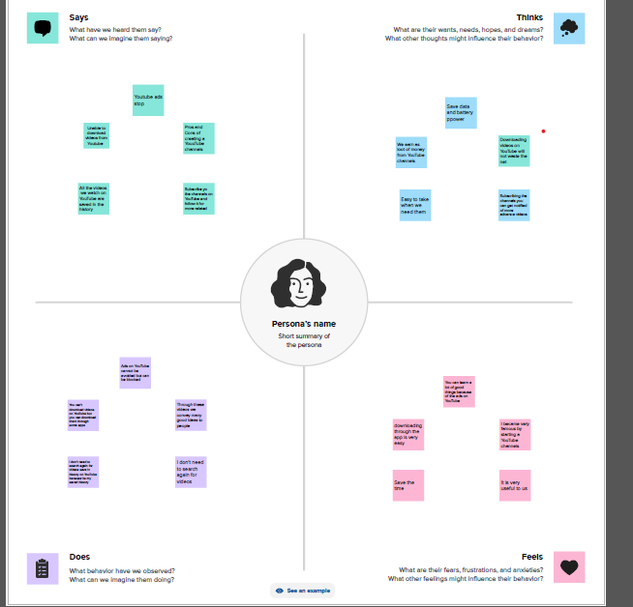

Slide 4
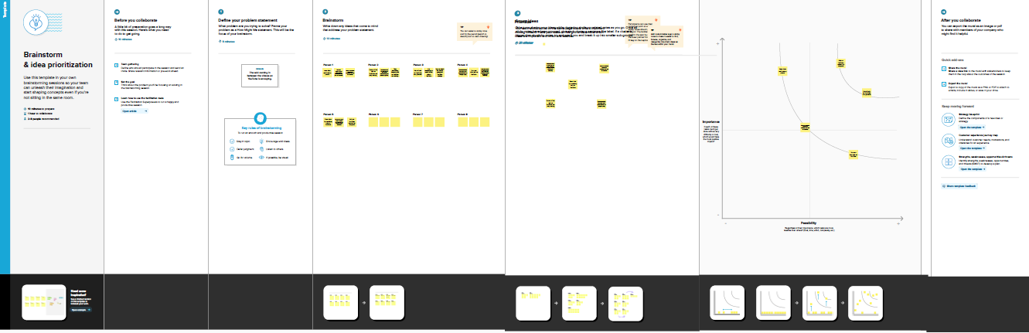

Slide 5


Slide 6
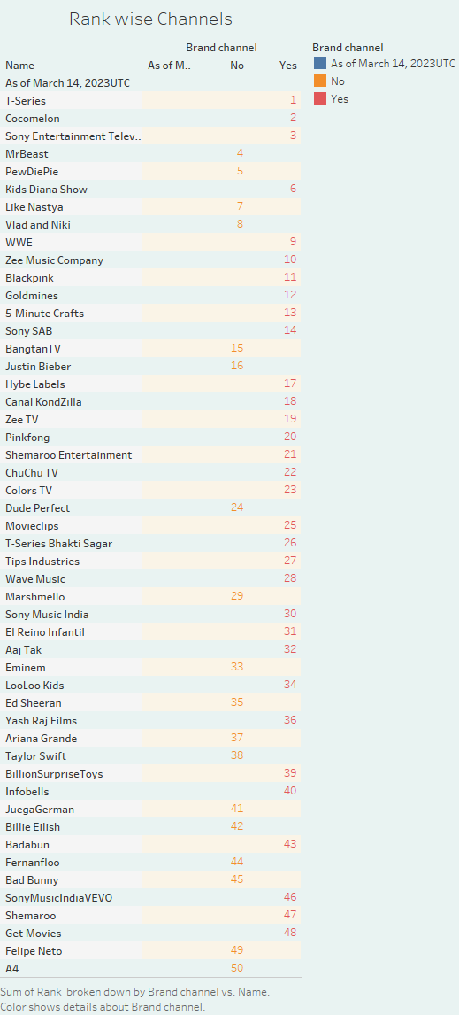

Slide 7


Slide 8


Slide 9
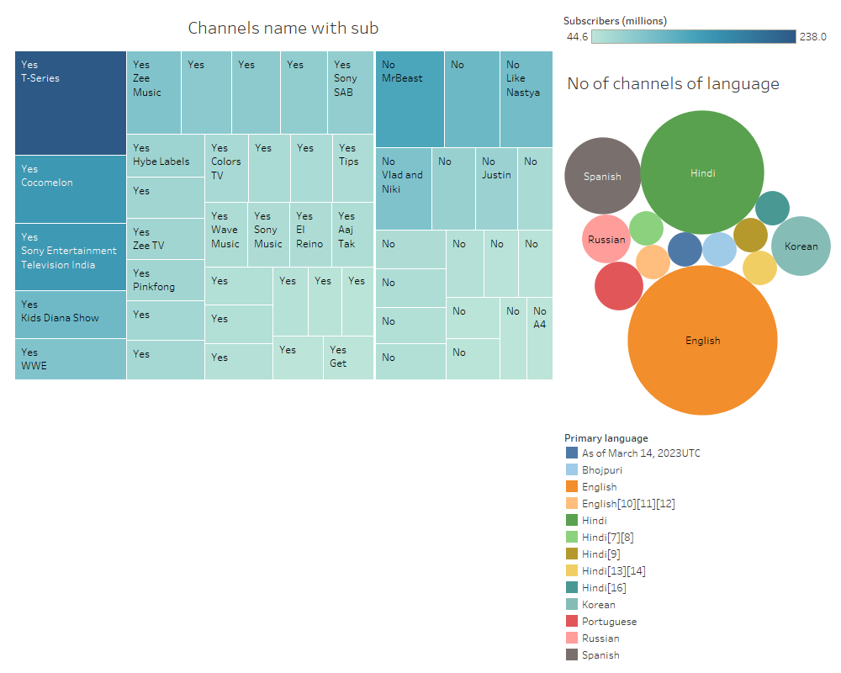

Slide 10


Slide 11
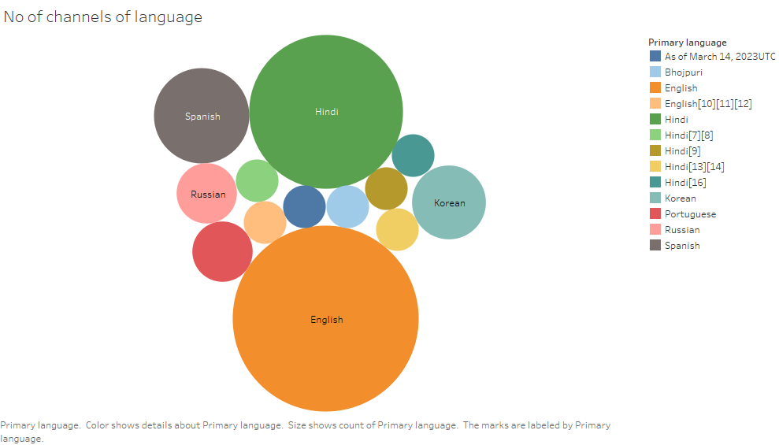

Slide 12
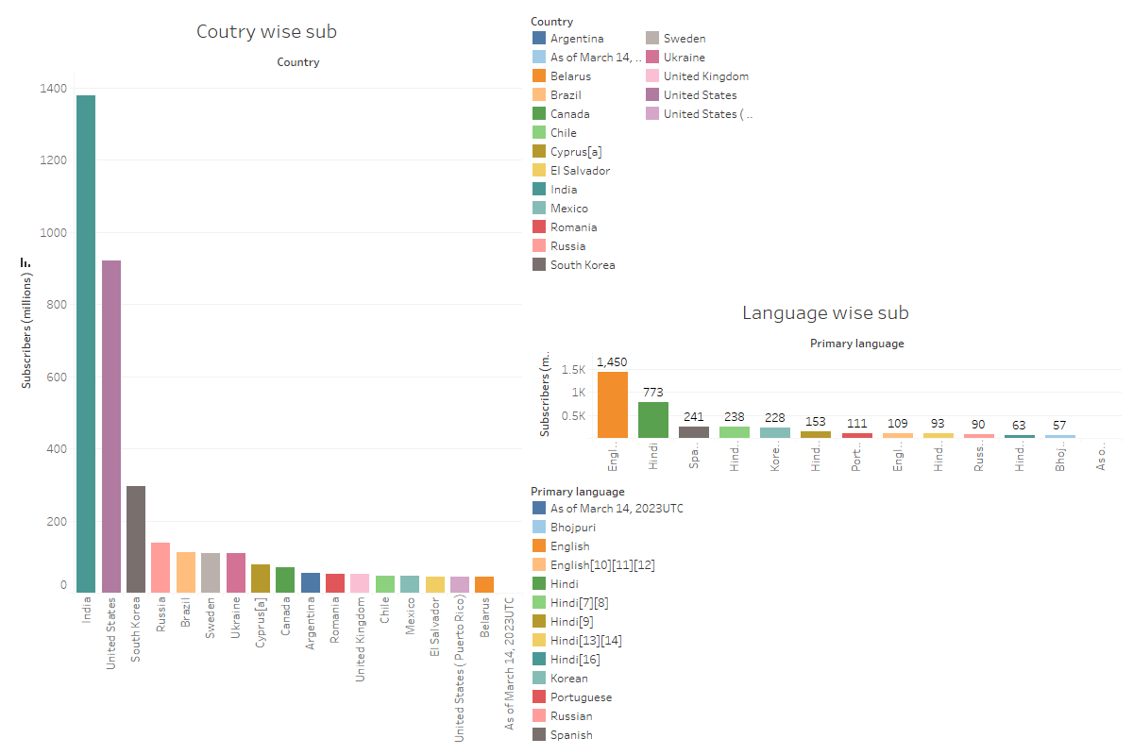

Slide 13
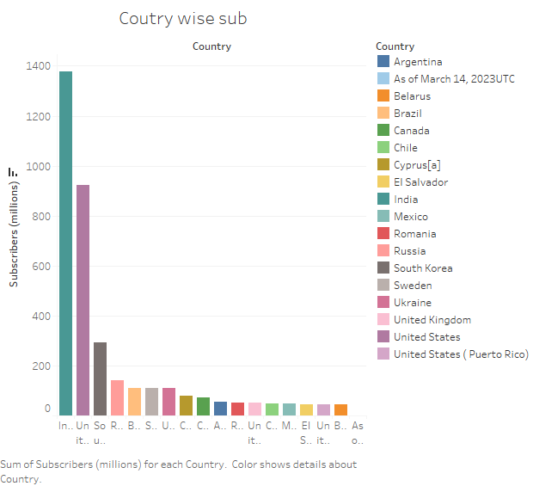

Slide 14
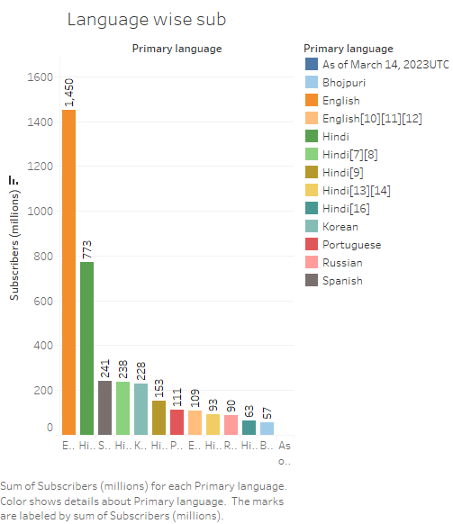

Slide 15
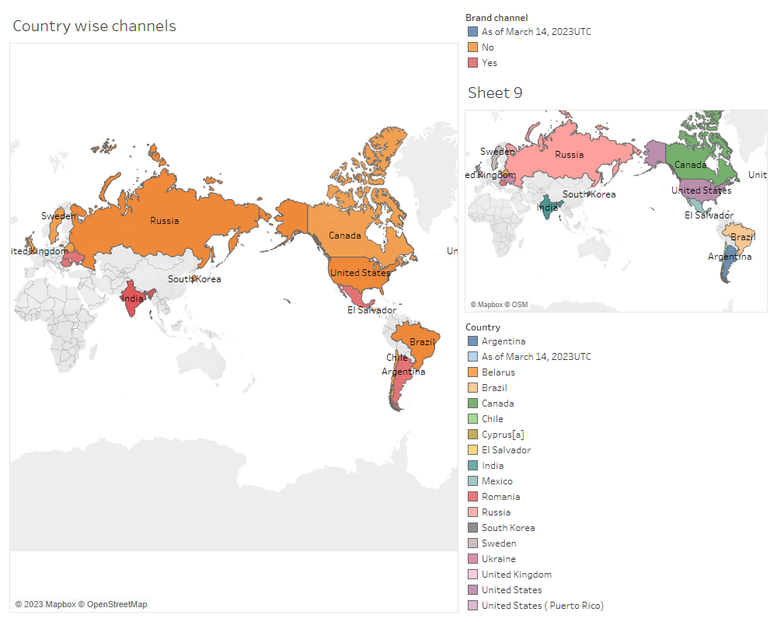

Slide 16
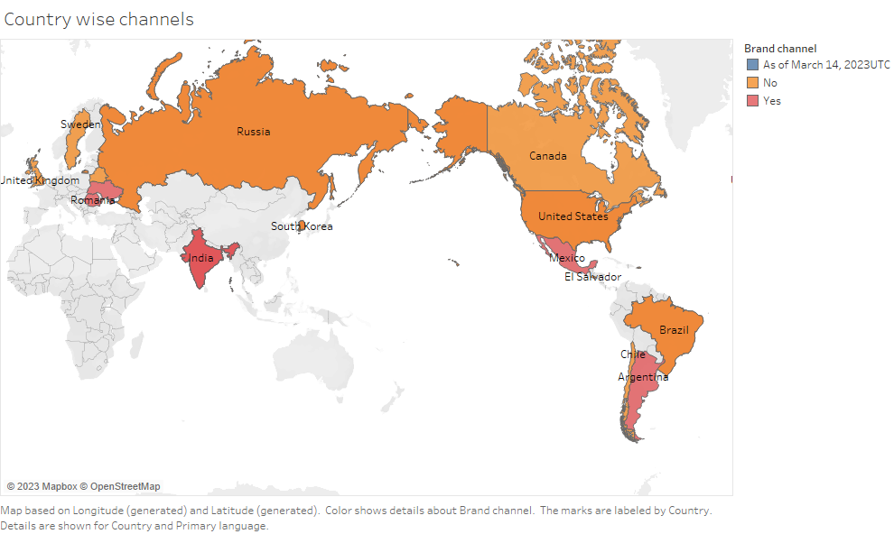

Slide 17
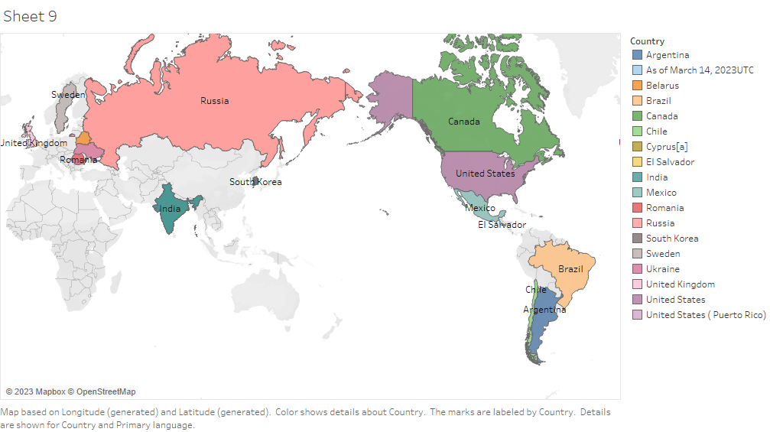

Slide 18
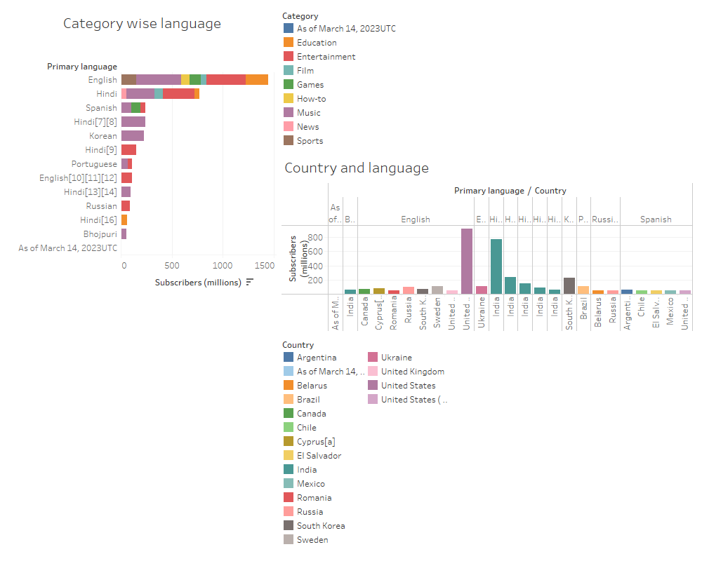

Slide 19
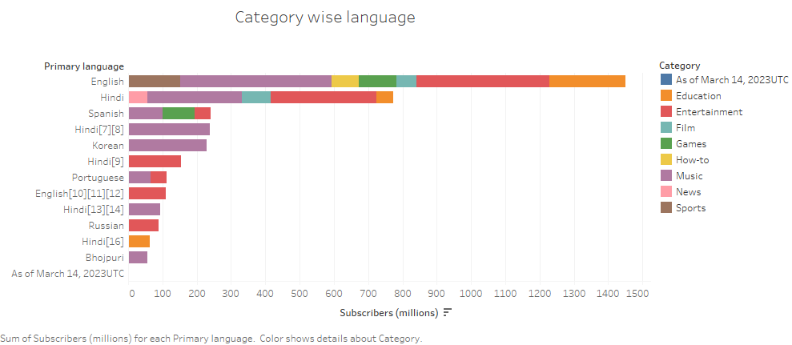

Slide 20
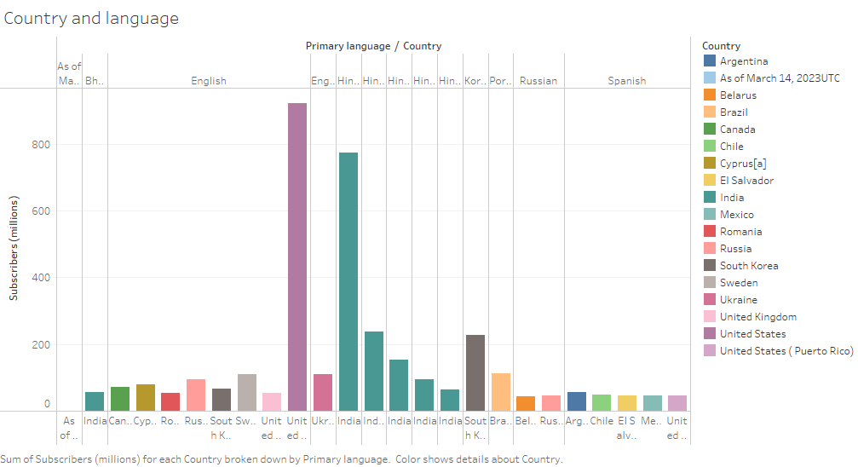

Slide 21
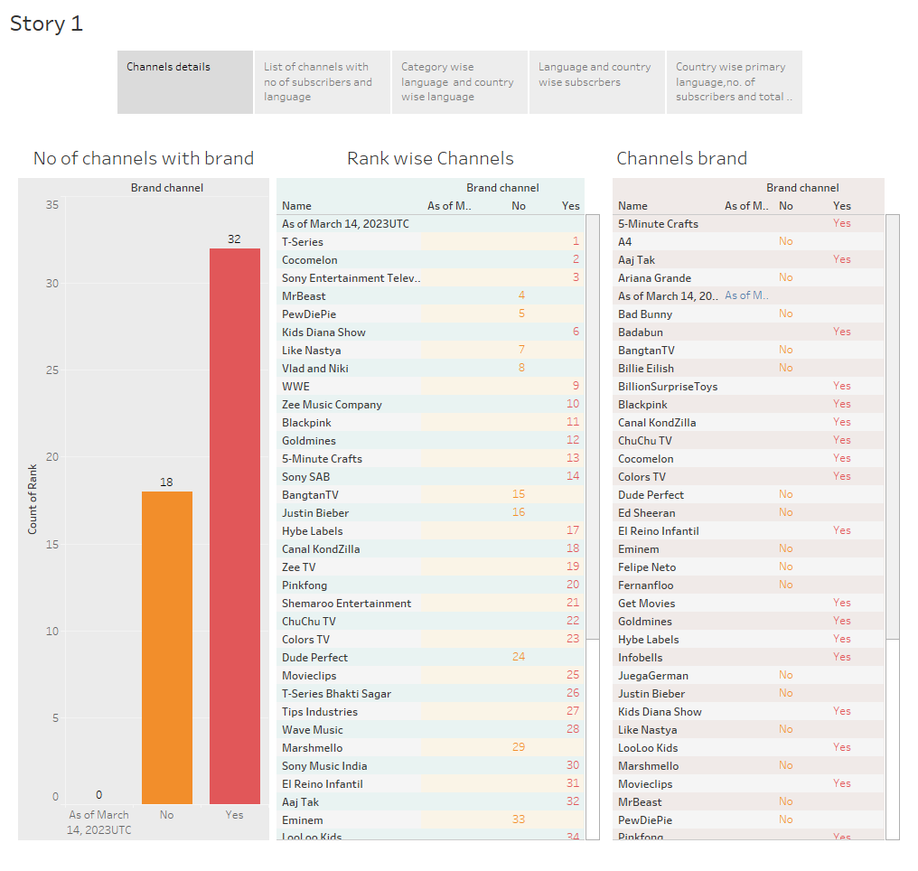

Slide 22
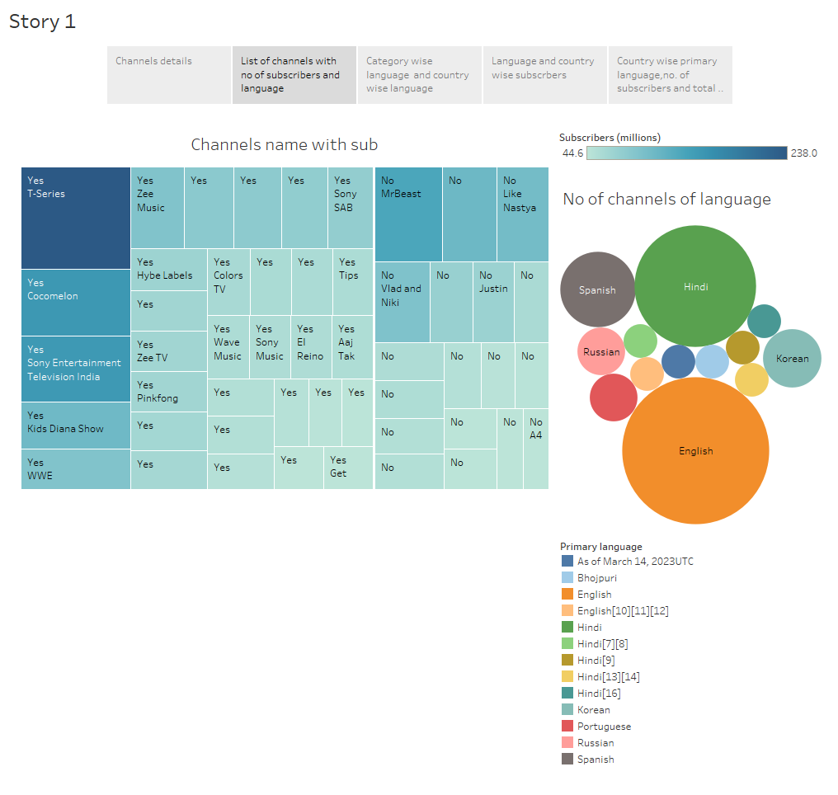

Slide 23
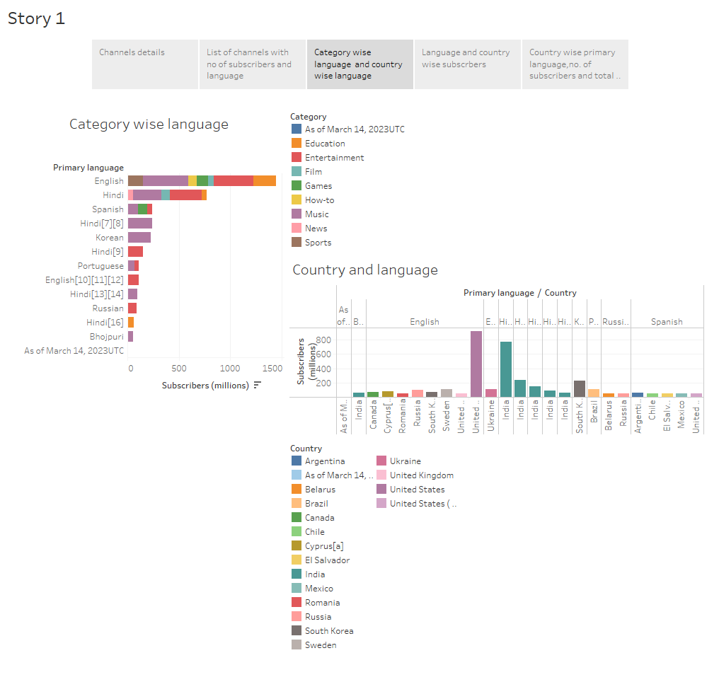

Slide 24
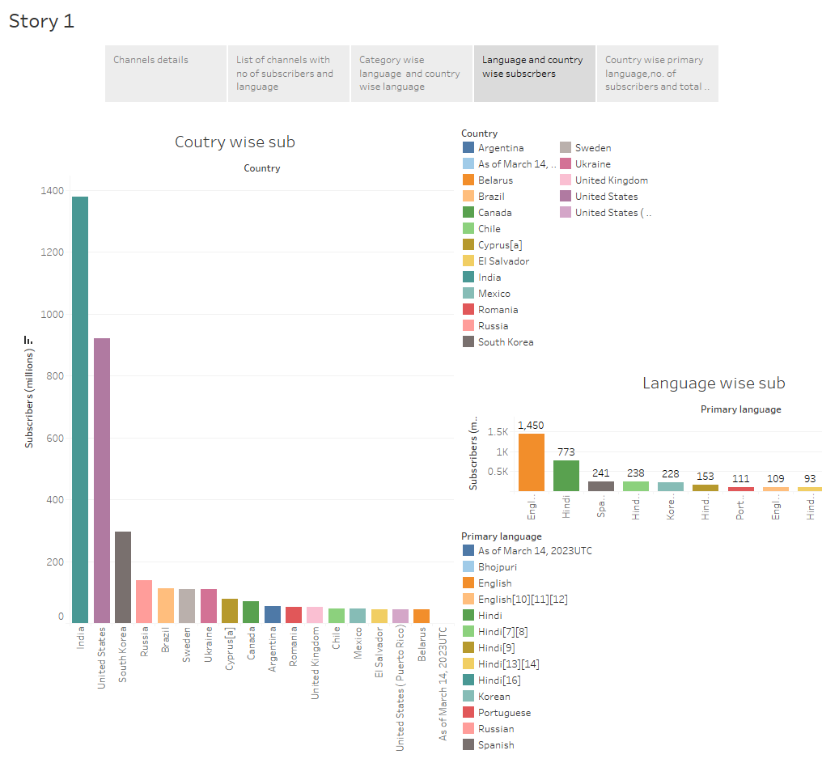

Slide 25
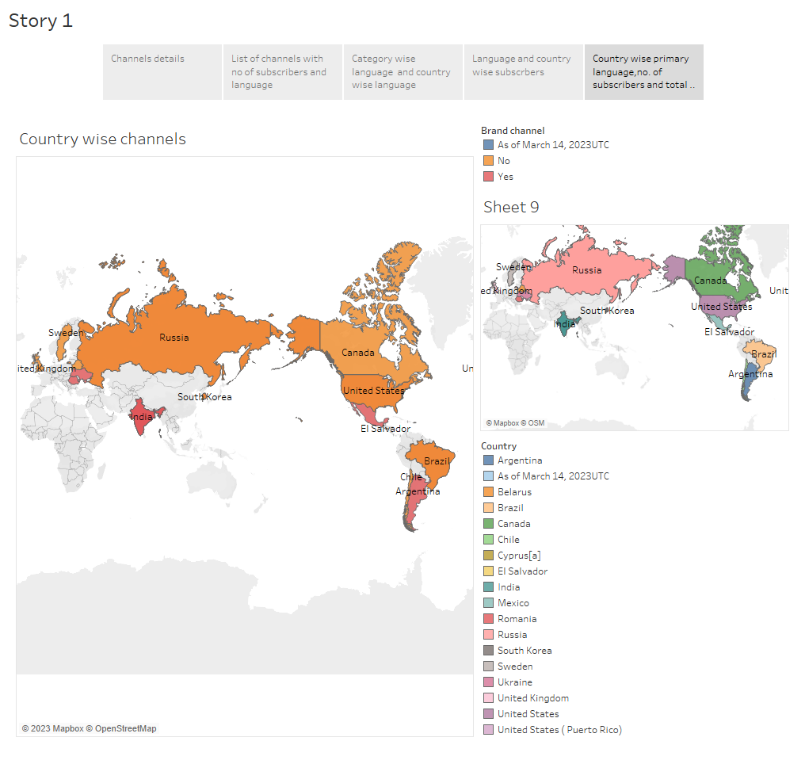

Slide 26

THANK YOU

